Slide 1
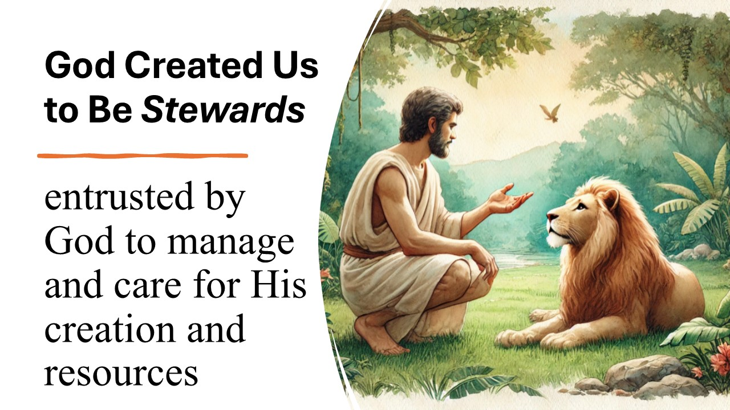
Stewarding God’s Creation: A Smart & Faithful Opportunity
Turning Power Plant Emissions into Jobs, Revenue & Blessing
Church of Eternal
Pastor Chris' Blog: Stewardship & Responsibility - Reflections from Eden | A Sermon on Genesis 2:15-20 & Matthew 25:15-30
Notes:
Good morning, family. Today we’re exploring a practical way our church can love God’s creation and our neighbors at the same time.”

Slide 2

Biblical Foundation: God Calls Us to Be Stewards
“The Lord God took the man and put him in the Garden of Eden to work it and take care of it.” — Genesis 2:15;
“The earth is the Lord’s, and everything in it.” — Psalm 24:1
Our NY based church is perfectly positioned to lead
Are We, Indeed, the Stewards of Eden? - Cateclesia Institute
Notes:
This isn’t politics — it’s obedience to Scripture.

Slide 3
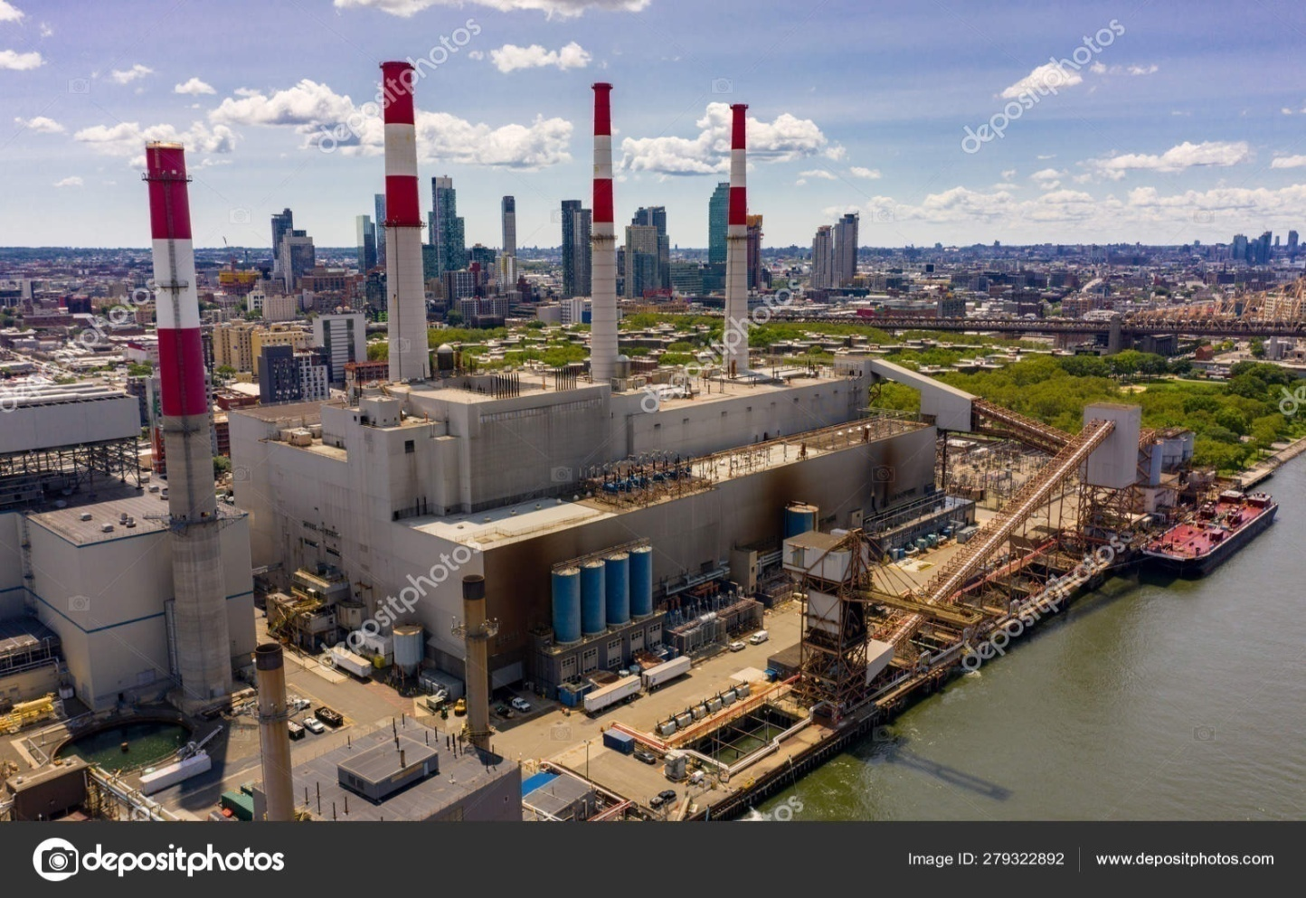
The Challenge in New York
New York’s Natural-Gas Plants Release Millions of Tons of CO₂ Every Year
Ravenswood (Queens) — 1.29 million tons
Astoria Complex — 717,000 tons
Arthur Kill (Staten Island) — 635,000 tons
Bethlehem (Albany area) — 2.27 million tons
Ravenswood Generating Station Long Island City New York
Notes:
These are real plants right in our communities. We don’t have to shut them down — we can transform their exhaust.”

Slide 4
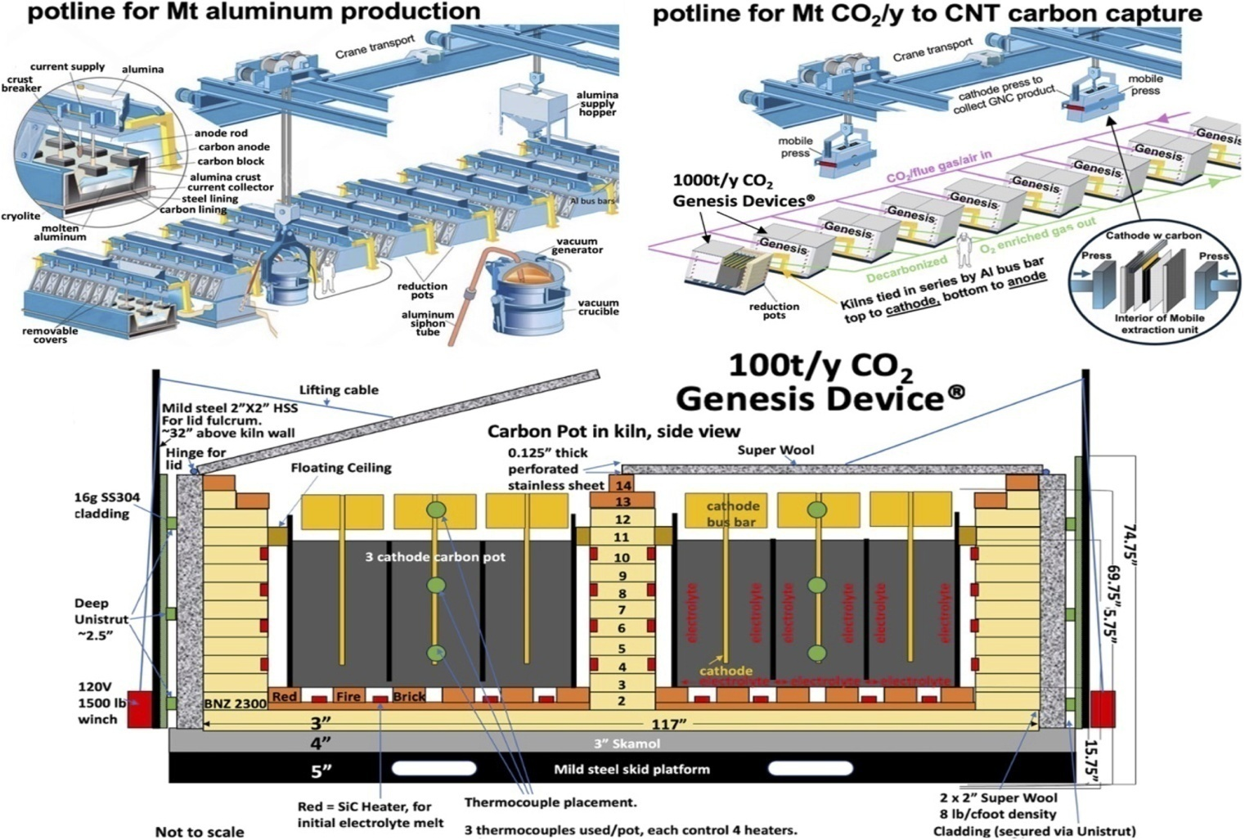
The Proven Solution Title: SkyNano’s Technology: Flue Gas → Valuable Carbon Nanotubes
Already demonstrated on real power-plant exhaust
Molten-salt electrolysis captures CO₂ and turns it into high-purity CNTs + pure oxygen
CNTs are used in batteries, tires, composites — sold at premium prices
Large-scale electrolytic molten carbonate carbon capture and transformation to carbon nanotubes and other graphene nanocarbons
Notes:
This is not experimental — it’s working today

Slide 5
What the CNTs Actually Look Like Title: High-Value Product = High-Value Impact
MSE PRO High Purity Graphitized Carboxylic Multi-Walled Carbon Nanotubes, 30g – MSE Supplies LLC
Though this image depicts a seemingly twisted morass of hair, its quite misleading in its the apparent lack of value. Indeed what you see is a microscope view of CNTs (Carbon nano tubes) –a truly high-value product we'll create from emissions.
To show Just how valuable these microscopic strands are; and why. One need
Only understand that these tiny tubes are stronger than steel and worth up to $40 - $85 / per ton.
Notes:
These tiny tubes are stronger than steel and worth up to $40,000 per ton.”

Slide 6
New York Financial Opportunity:n Real Numbers – Even at 80% Capture Rate
Full-Scale Potential (Revenue Highlight) Full-Scale Vision – Ravenswood Example (80% Capture of Carbon)
Small modular start: 100–500 tons CO₂/year
CNT produced: 22–110 tons/year (market-ready)
45Q credits: $8,500 – $42,500/year
CNT sales: $880,000 – $4,400,000/year
Total gross revenue: $888,500 – $4,442,500/year
After OPEX (electricity dominant): Net positive quickly
Notes:
These are annual figures reflect year one. We start small and grow with the cash flow. Toward a billion dollar Revenue stream at scale”

Slide 7
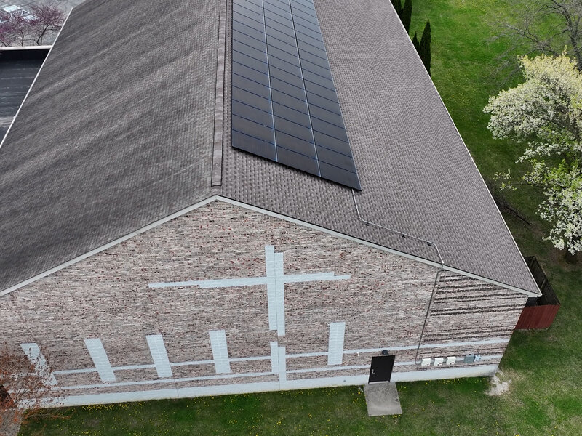
How We Make It Happen Title: Our Church-Owned For-Profit Subsidiary Model
100% owned by our 501(c)(3) church Protects tax-exempt status
Eligible for federal 45Q credits + SBIR grants + NYSERDA funding
Revenue returns to ministry, jobs, and outreach
Notes:
This is the same model many churches already use for solar and community development

Slide 8
Community & Kingdom Impact Title: Local Jobs + Ministry Funding
Manufacturing and operations jobs right here in New York
Revenue supports missions, scholarships, food pantry, and more
Permanent carbon storage in durable products = true stewardship
Notes:
We create good jobs while literally locking carbon away for centuries

Slide 9
Why This Is Wise & Faithful : Intelligent + Aligned with Our Values
Proven technology
Massive federal incentives already in place
Multi-state synergy (NY, NJ, MD, TX)
Turns a problem into blessing — exactly what good stewards do
Notes:
This isn’t risky speculation — it’s strategic, faith-filled innovation

Slide 10
Next Faithful Steps: Let’s Move Forward Together
Approve formation of the subsidiary Devine Stweartship LLC
Reach out to SkyNano for licensing
Submit first grant applications (already drafted)
Start with a small pilot at one New York plant
Call to Action: “Would you pray with us and support this work?”

